Slide 1

Nashville Housing Data Cleaning Project
Preparing data for Analysis

Slide 2
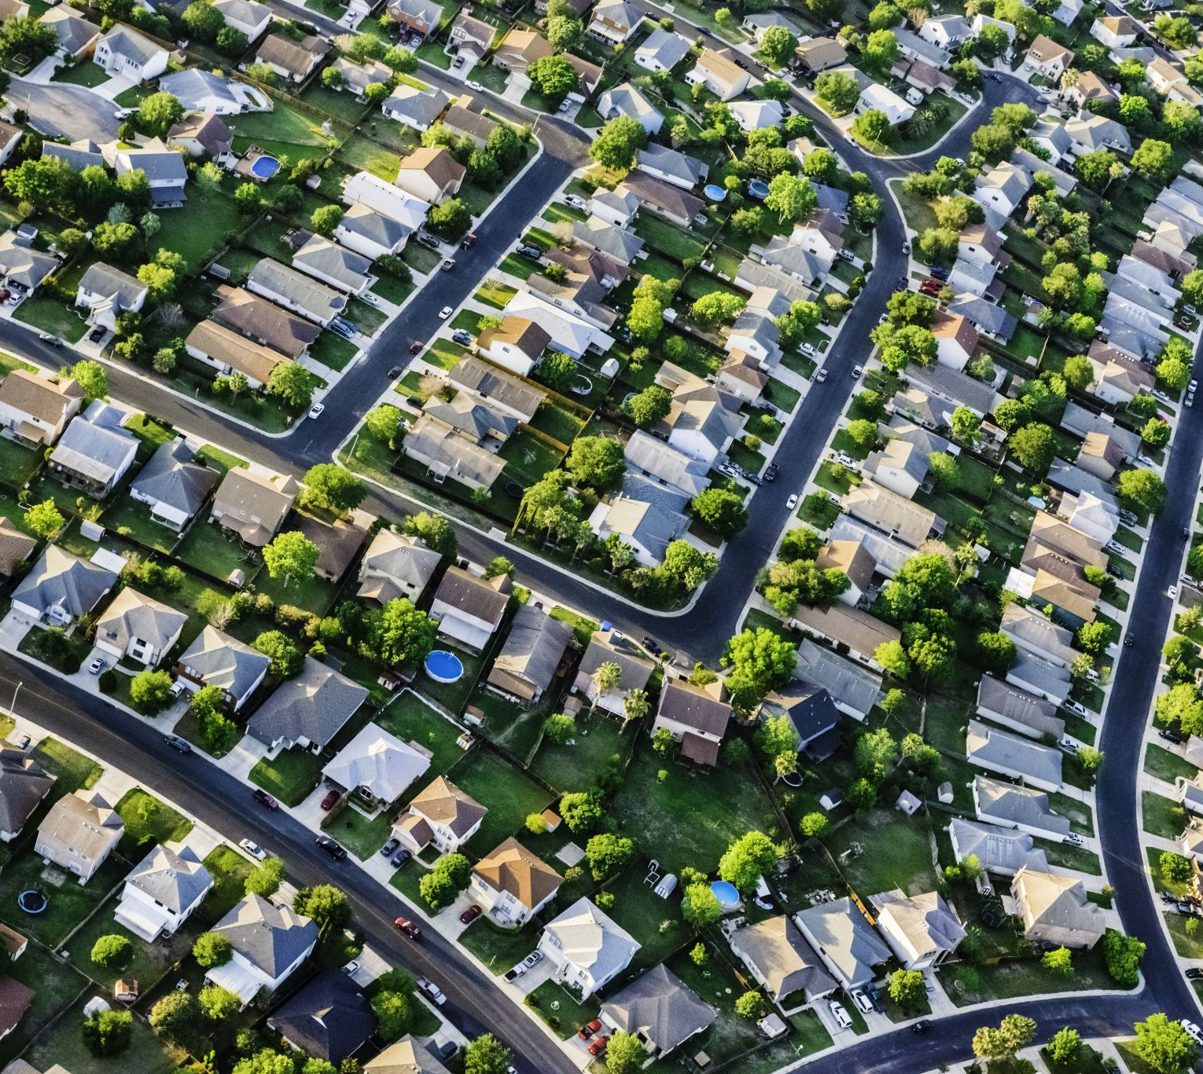
Project Objective
The primary goal of this project was to clean the Nashville real estate housing data.
This cleaning process is crucial to prepare the data for analysis.
The prepared data will enable us to understand sales trends, identify popular housing types, and determine average housing prices in the Nashville area.

Slide 3

SQL Concepts Used
SELECT: Leveraged SELECT statements to meticulously query and validate the dataset, ensuring accuracy and completeness for subsequent analysis.
Data Type Conversion: Used to standardize the format of columns (e.g., converting the SaleDate column to the correct date format).
String Manipulation & Extraction: Utilized string functions, including PARSENAME, to dissect and extract pertinent information from text-based columns, such as isolating city names from full addresses, enhancing data granularity.
Self-Join for Null Value Imputation: Implemented SELF JOIN operations to effectively impute missing PropertyAddress values, capitalizing on the inherent relationships within the dataset.
Window Functions: Deployed window functions, specifically RANK, to efficiently identify and flag duplicate records, facilitating data deduplication
Data Manipulation Statements: Executed UPDATE, DROP, and ALTER statements to transform the dataset, including replacing null values, creating derived columns, and refining existing data points, aligning the data with analytical requirements.
Common Table Expressions (CTEs) for Query Optimization: Constructed CTEs to streamline complex queries, such as identifying duplicates across multiple columns, enhancing code readability and maintainability throughout the data cleaning process.

Slide 4
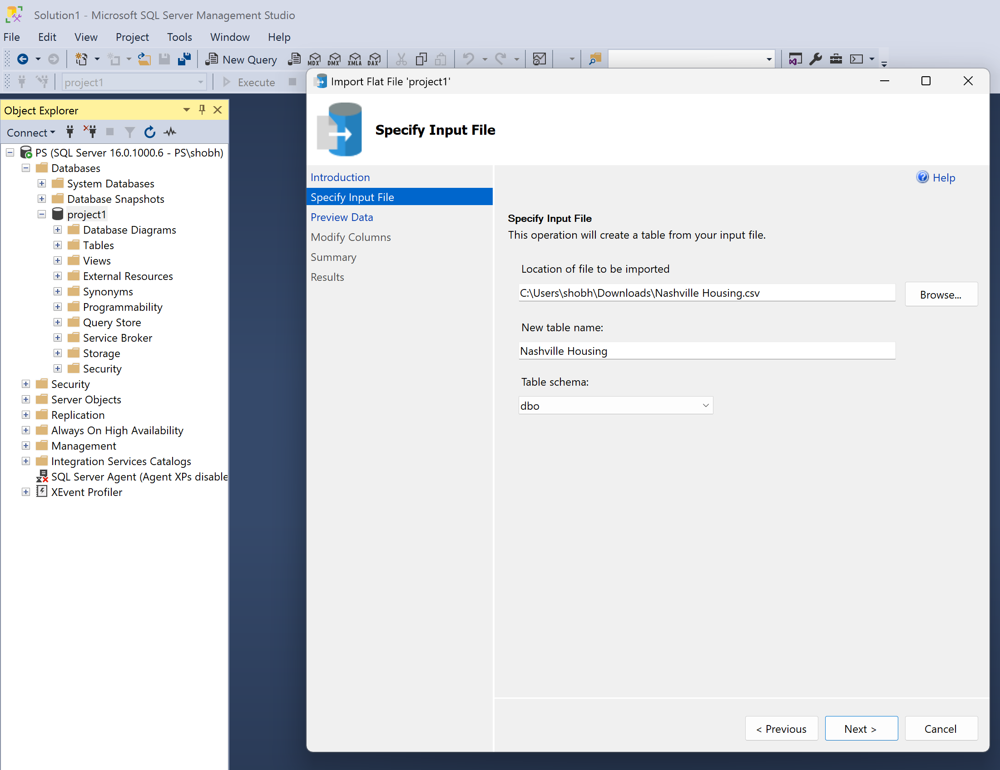
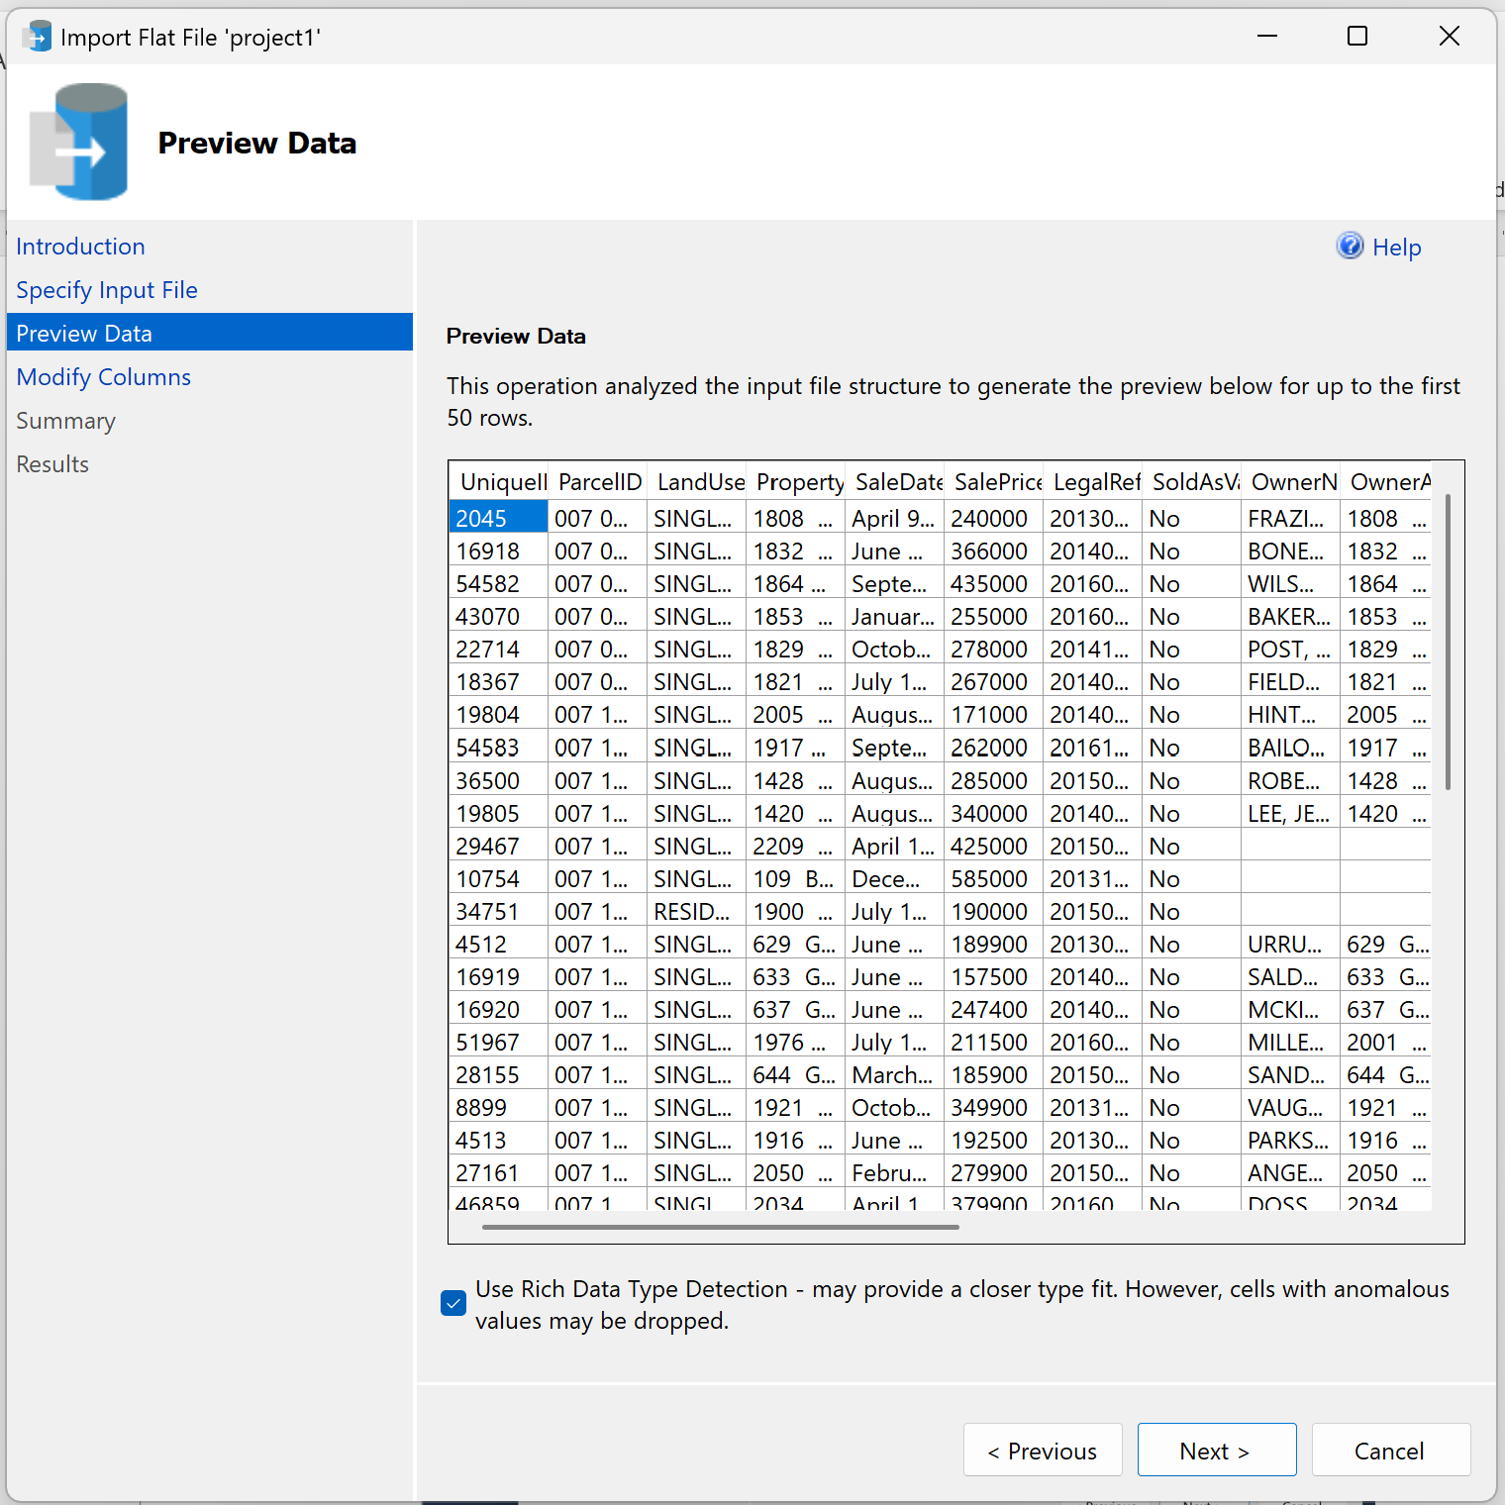
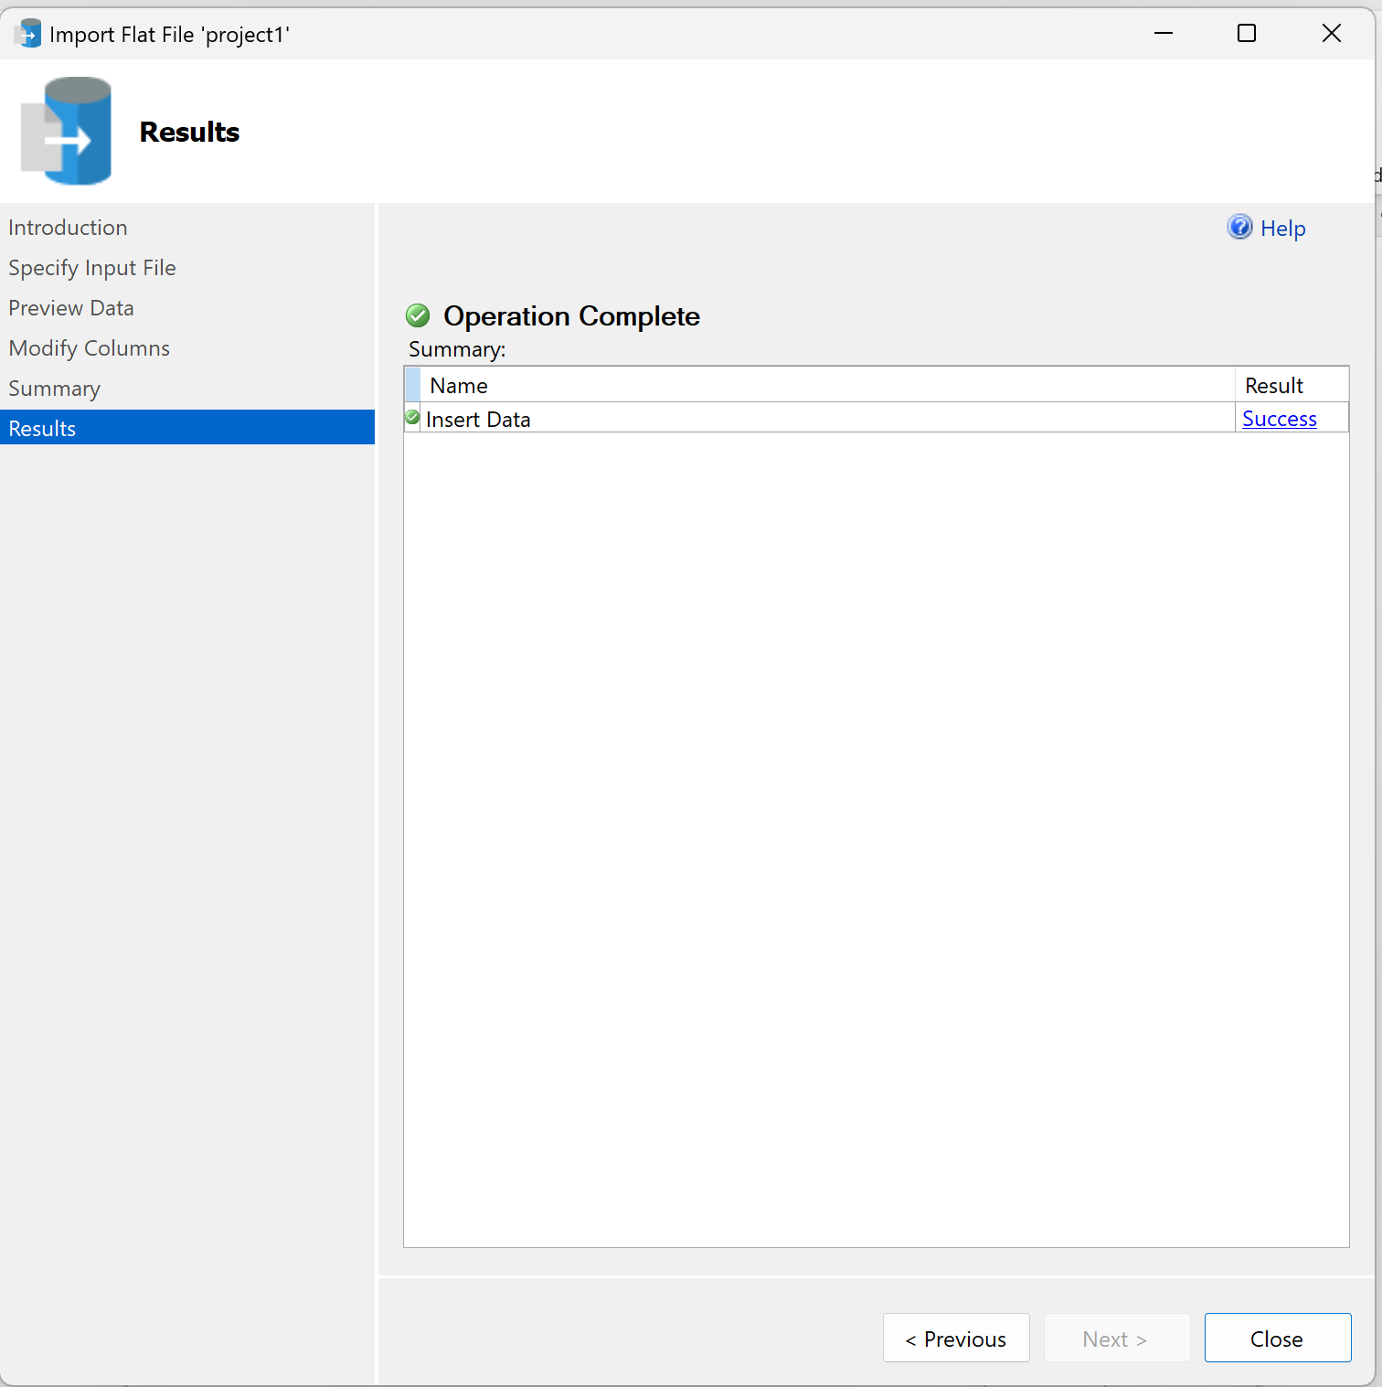
Data Loading & Verification
The initial steps involved loading the data into Microsoft SQL Server.

Slide 5
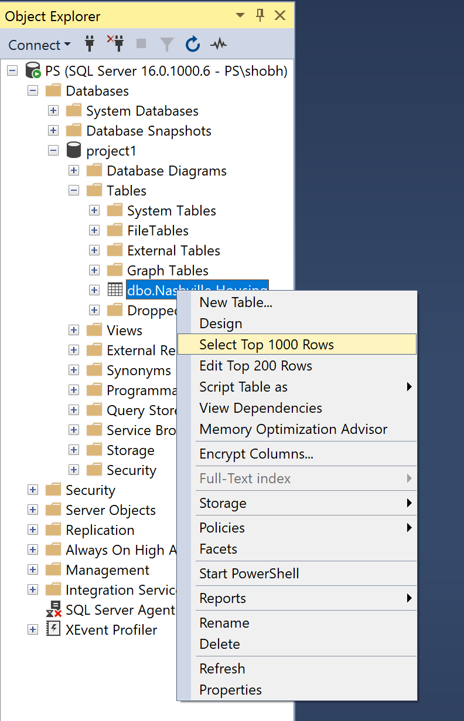
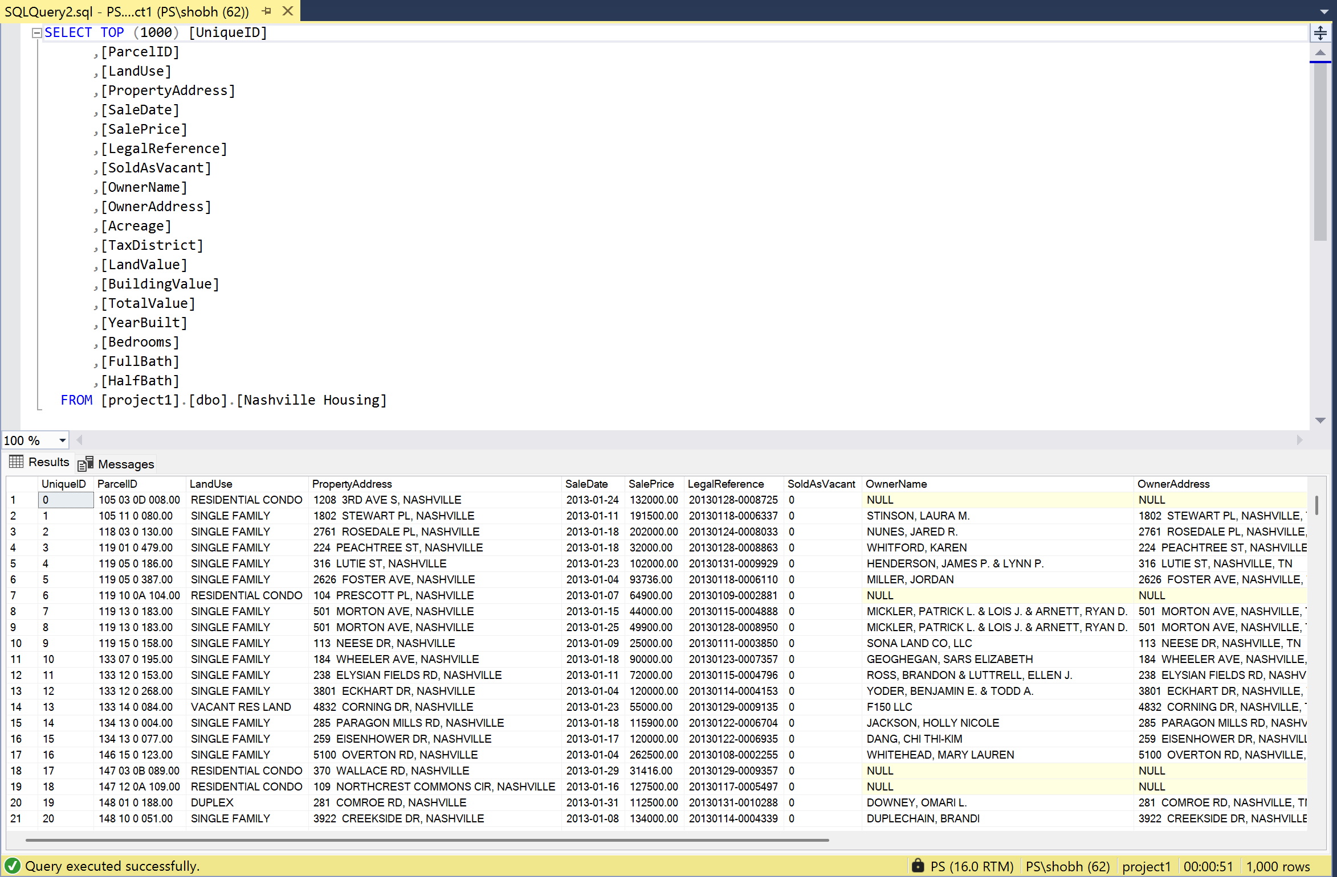
Data Exploration
The data in the new table was verified by querying data with top 1000 rows to ensure accuracy.
This also gives us a quick view of data like null values in this case.

Slide 6
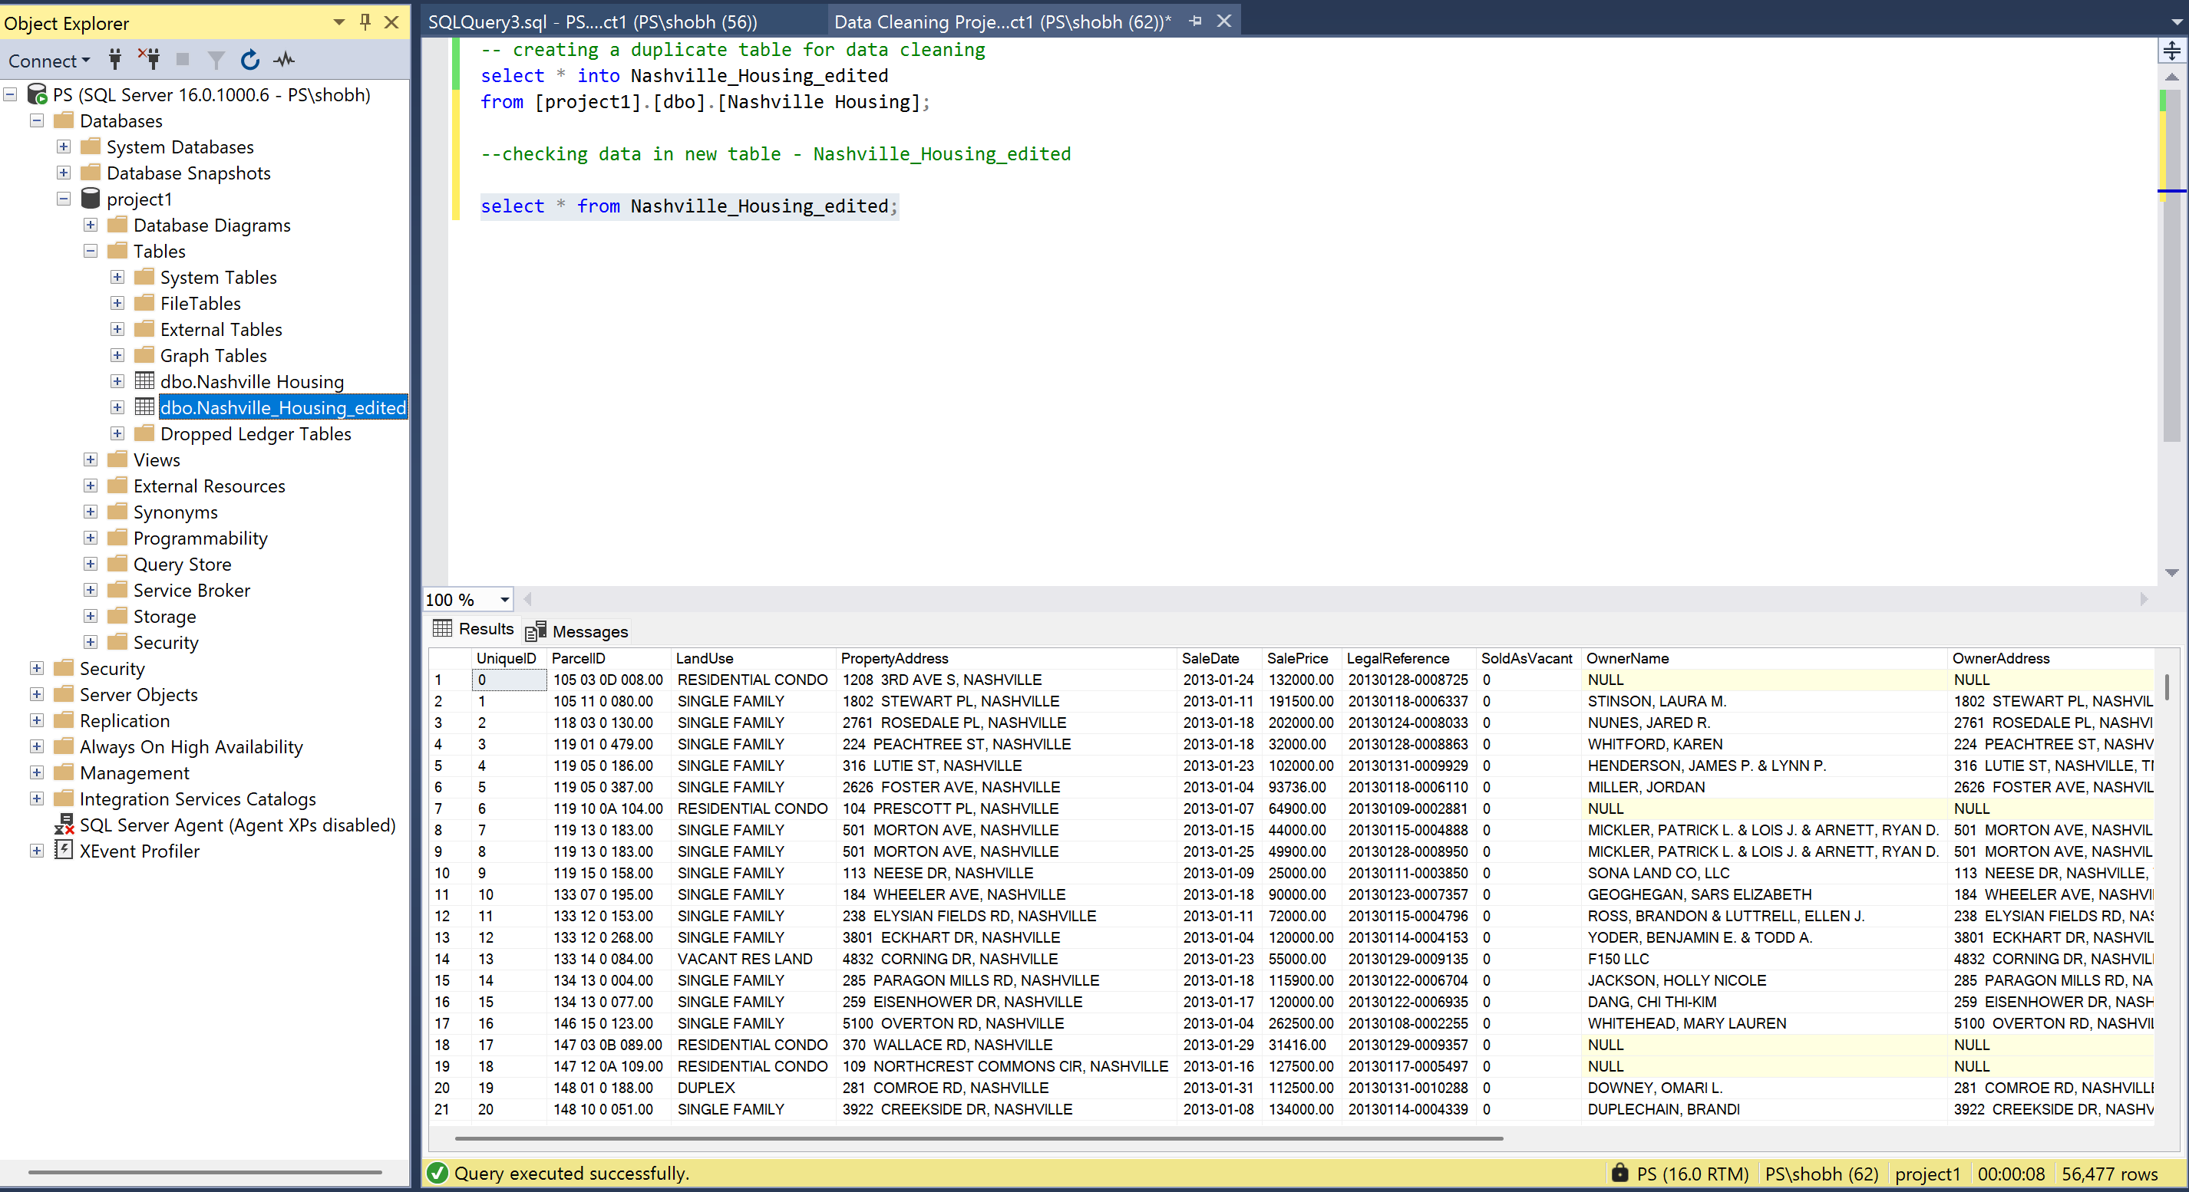
Data Exploration
A copy of the table was created for editing purposes which ensured source data is not affected.

Slide 7
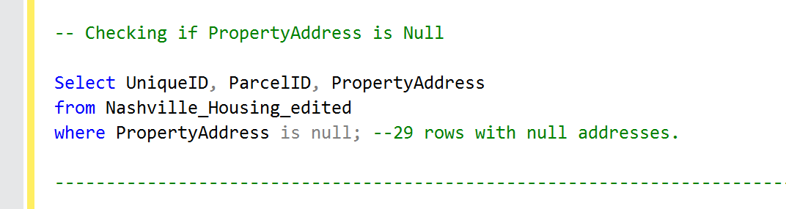
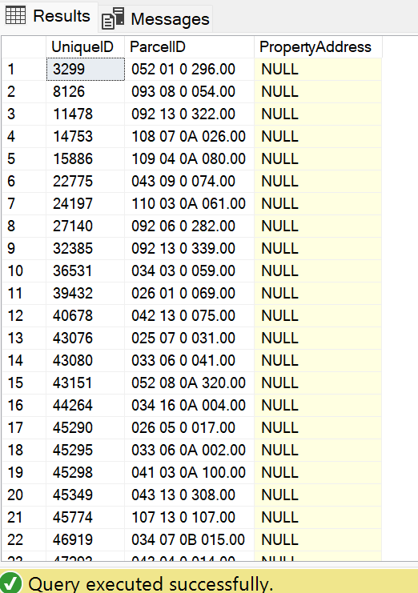
Treating Null Values
Queried PropertyAddress columnto check the number of missing values (null values).

Slide 8
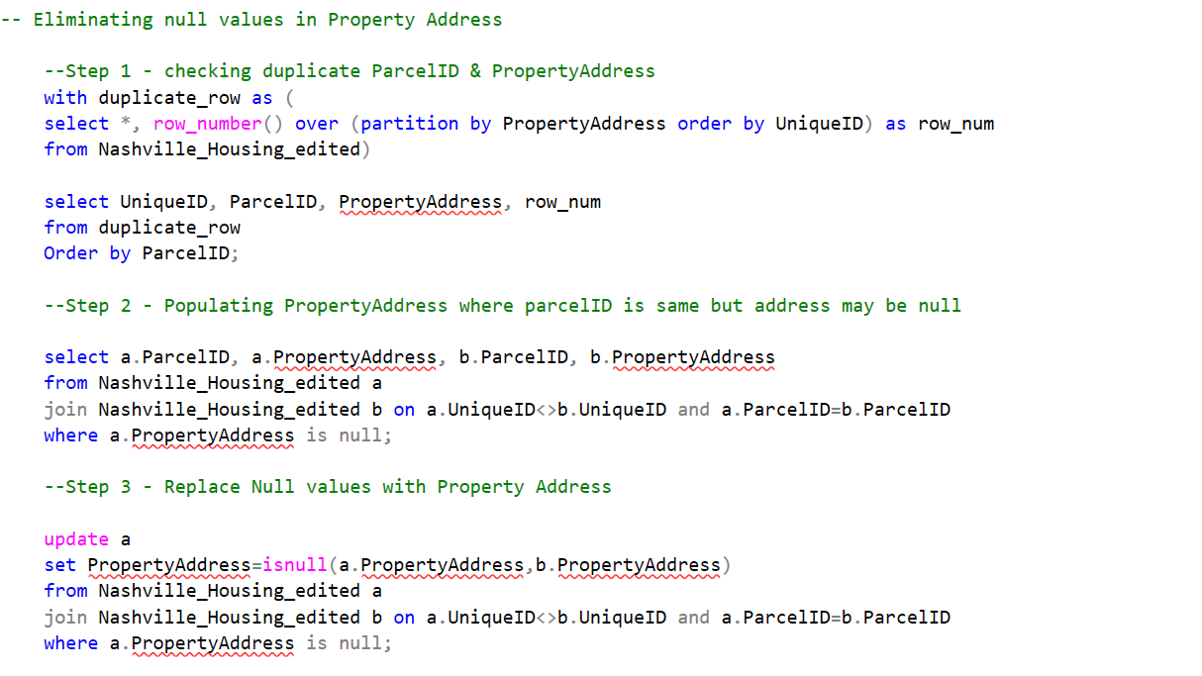
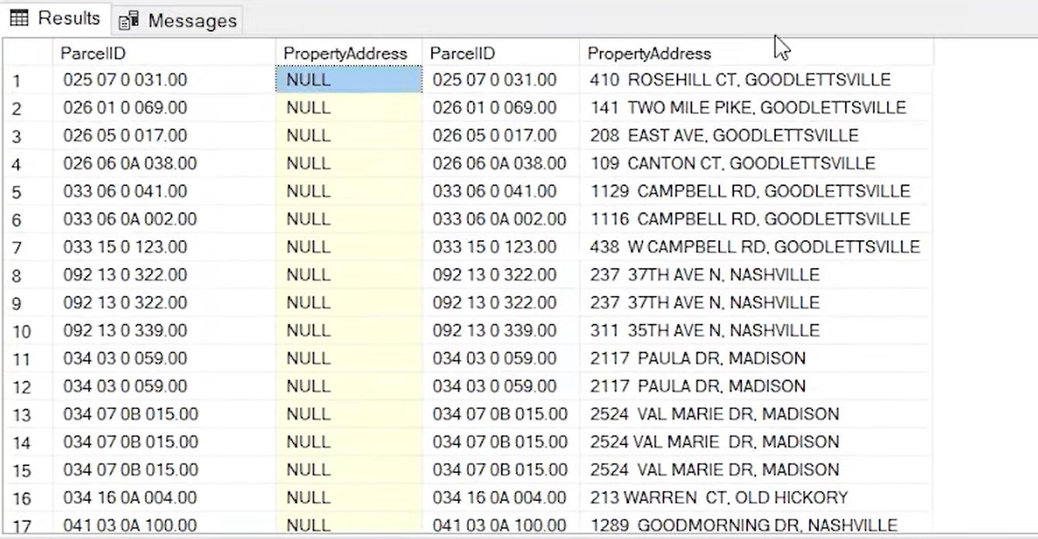
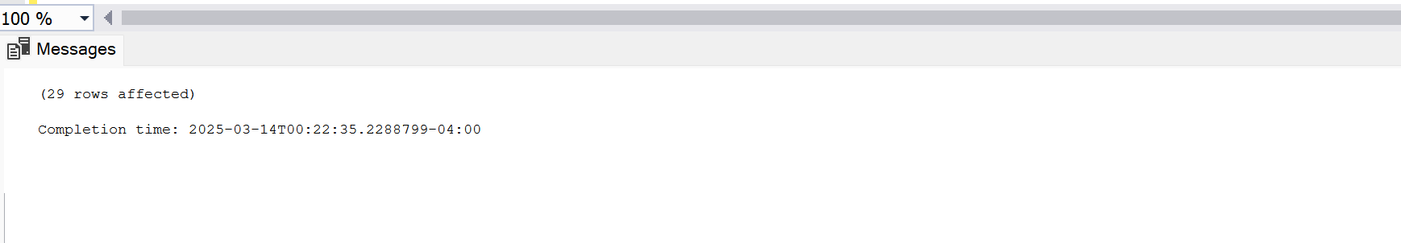
Treating Null Values
Missing values in the PropertyAddress column were populated in 3 steps –
Checked for the duplicate parcelID and their respective Property addresses.
It was observed that if the ParcelID is the same, the address is also the same, and this logic was used to fill in the null values.
after executing update statement, there were no null values in the address column.

Slide 9
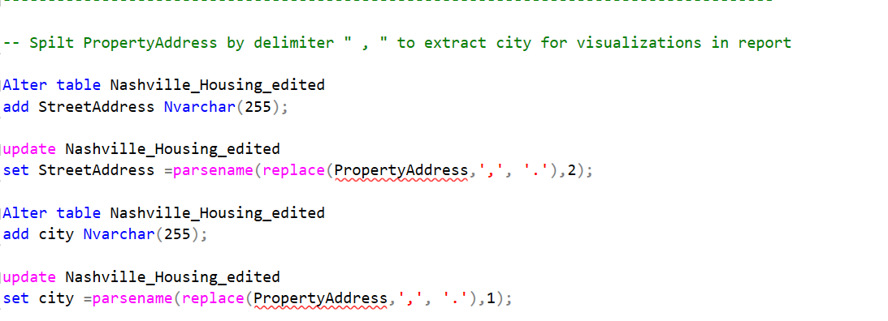
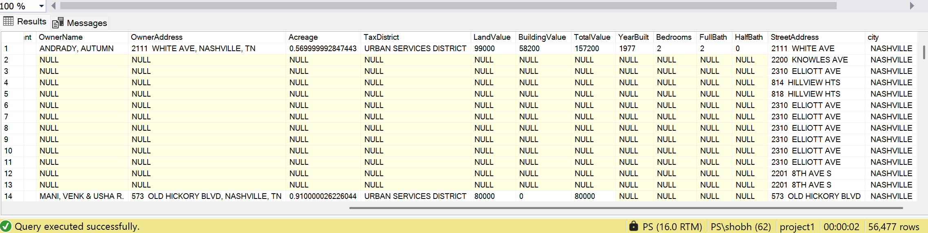
Data Extraction and Adjustment
This phase is essential because it enables us to extract the city, which can then be utilized for meaningful analysis and visualization steps.

Slide 10
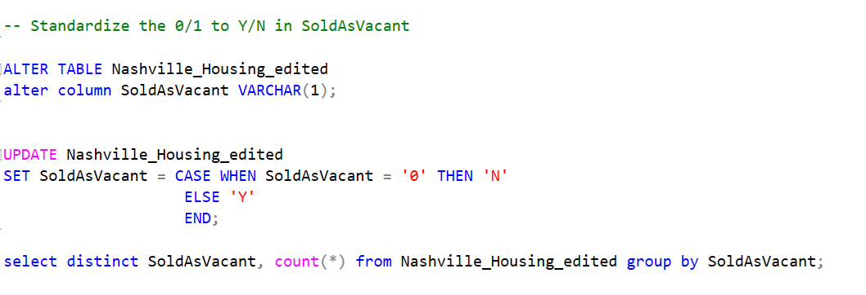
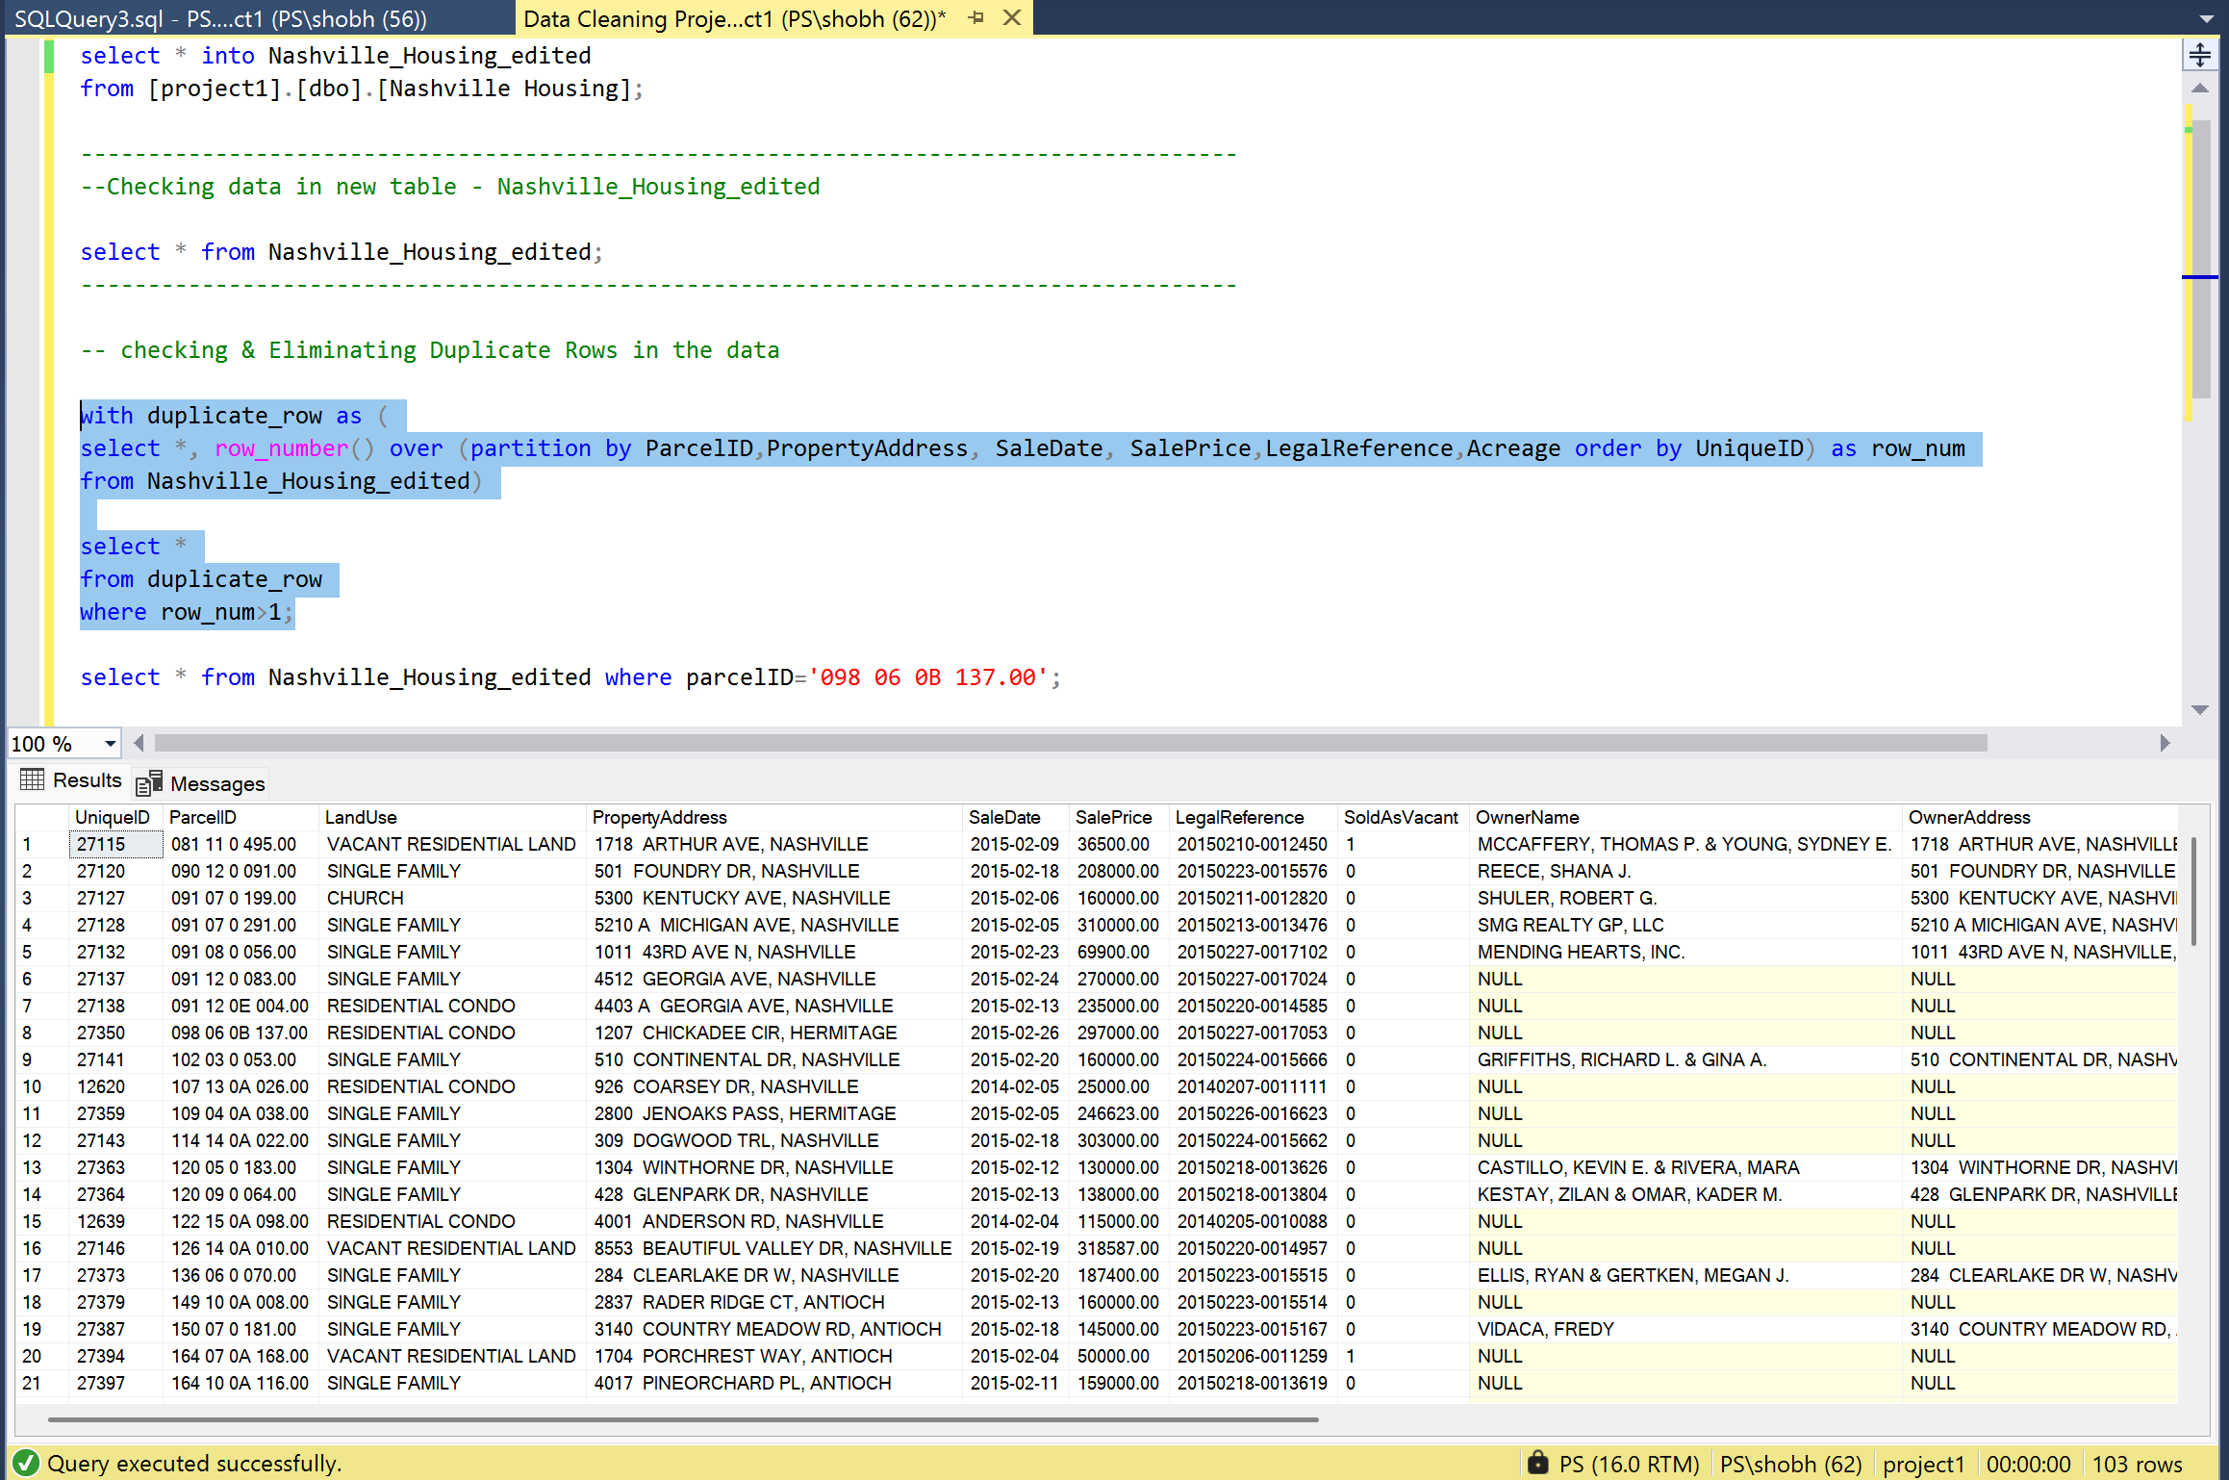
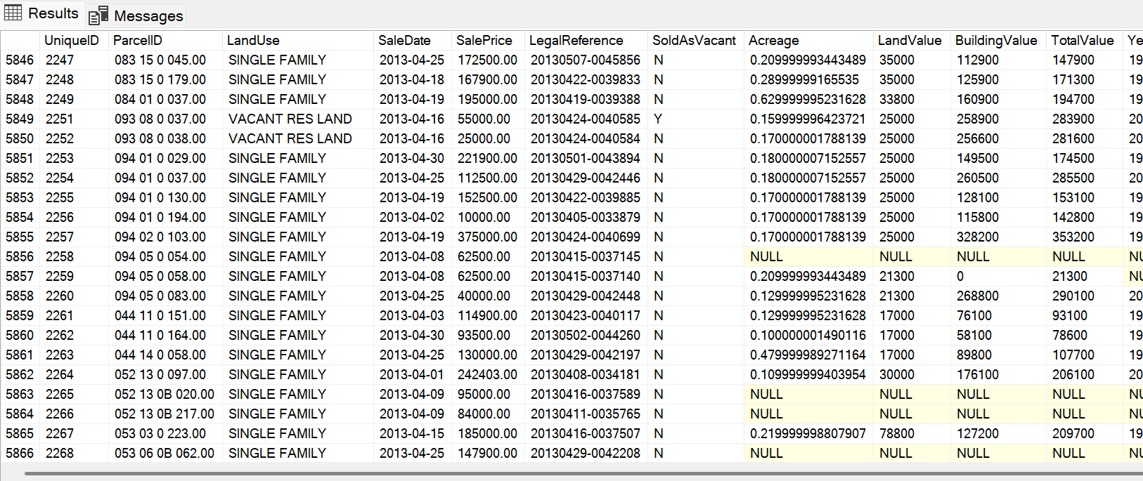
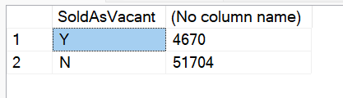
Data Standardization
Before
The "SoldAsVacant" column initially used "0" and "1" to indicate whether a property was sold as vacant.
To improve readability and consistency, these values were standardized to "Y" for "Yes" and "N" for "No."
After

Slide 11
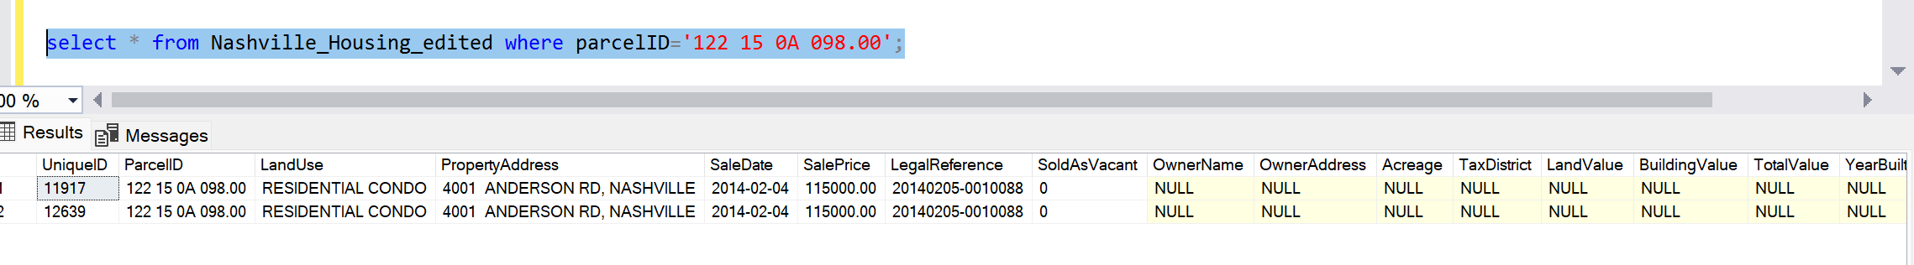
Handling Duplicates
A total of 103 duplicate values were found.
The duplicate rows were double-checked to confirm their redundancy before elimination.

Slide 12
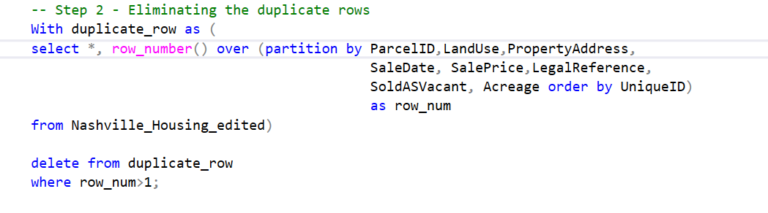
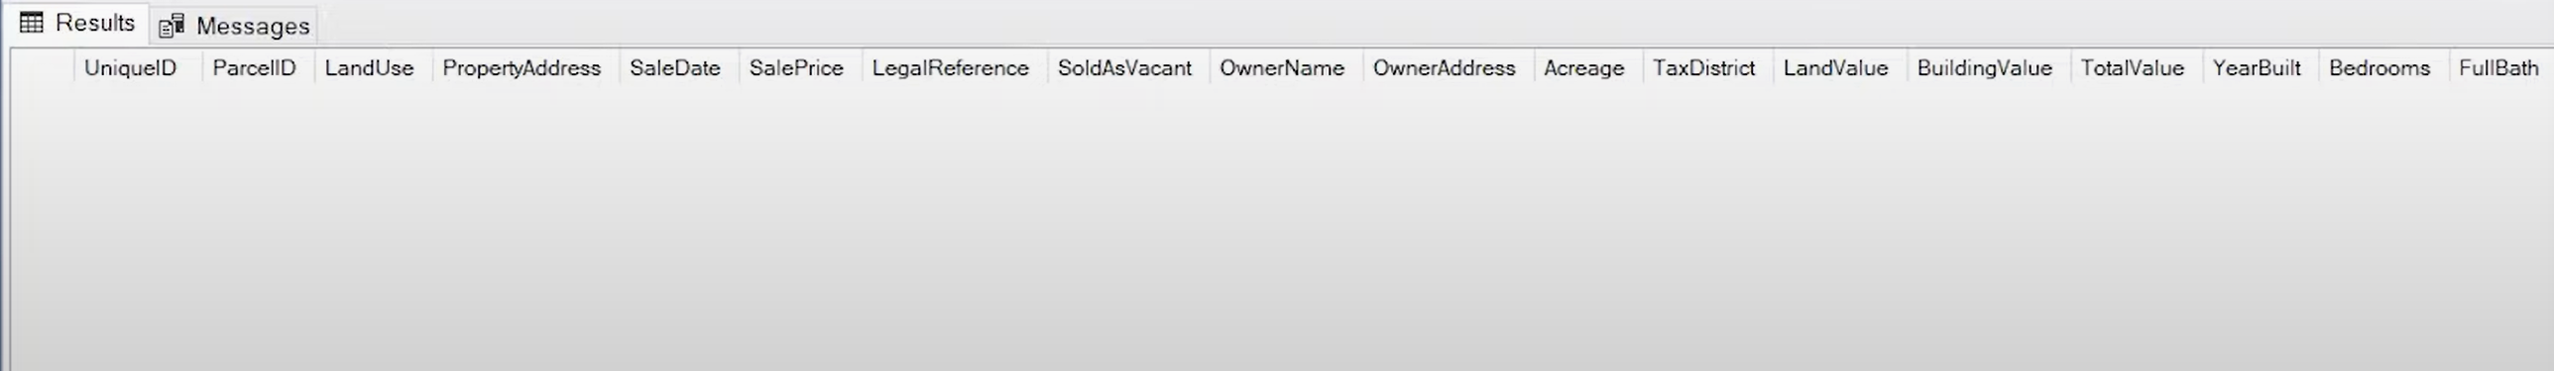
Handling Duplicates
Once necessary checks were done, duplicates were safely removed from the data.

Slide 13
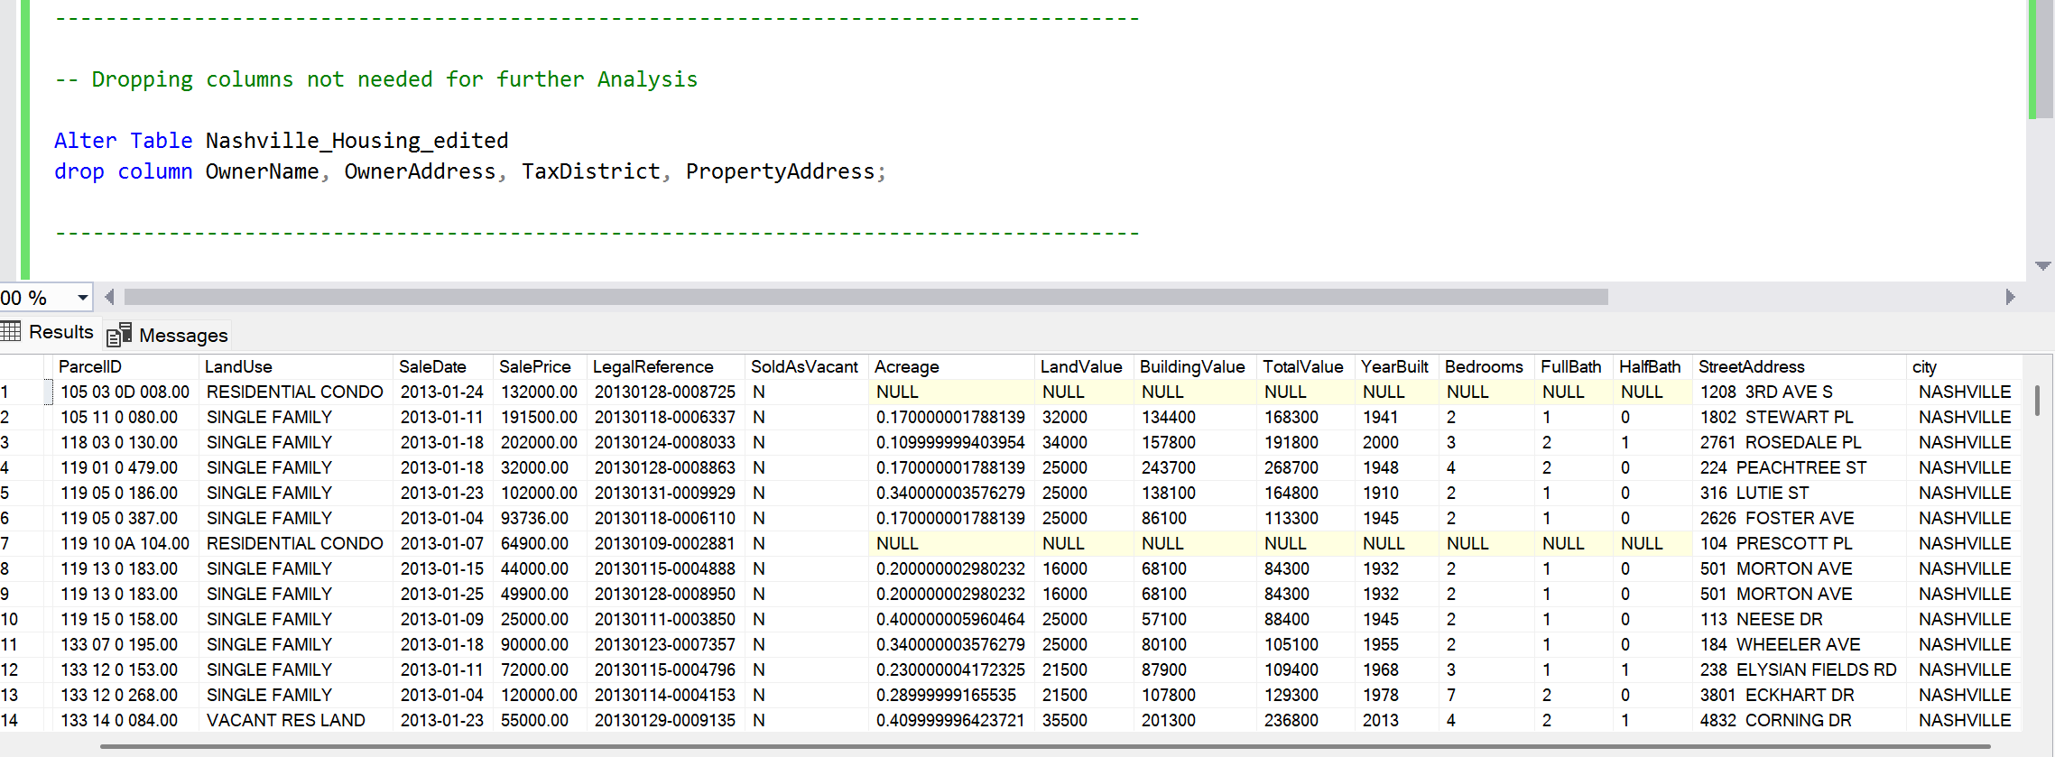
Dropping Columns
To further refine the dataset and focus on the most relevant information for our analysis goals, certain columns were deemed unnecessary and removed.
These columns were dropped because they were not essential for analyzing sales trends, housing types, and average prices. Like PropertyAddress, the information had been used to extract other more relevant data (like city) and was no longer needed in its original form.

Slide 14
Project Learnings
Importance of Data Cleaning: This project reinforced the critical role of data cleaning as a foundational step in any data analysis workflow.
Data Integrity: Maintaining data integrity by removing duplicates and handling null values is crucial for accurate analysis.
Data Transformation: Standardizing formats and extracting relevant information improves data usability.
Problem-Solving: Utilizing logical relationships within the data (e.g., ParcelID and address) can effectively address data quality issues.
Attention to Detail: Double-checking duplicate rows highlights the importance of meticulousness in data cleaning processes.

